Slide 1
Basic Microprocessor Hardware
ECE 611 Microprocessor Systems
Dr. Roger L. Haggard, Associate Professor
Department of Electrical and Computer Engineering
Tennessee Technological University
Spring 1998

Slide 2
Outline
Microprocessor Applications
Computer System Structure
Generic CPU, Memory, I/O
Specific Microprocessor Pinouts
Specific Microprocessor Timing

Slide 3
Introduction
Computer System - Hardware and Software
Typical Processors:
  8086 Microprocessor
  68000 Microprocessor
  8051 Microcomputer or Microcontroller
  Why different?

Slide 4
Applications of Microprocessors
2 Broad Applications:
General purpose computer
  runs user programs
  big memory, big peripherals
  modular, complex, expandable
Embedded Computer
  invisible to user
  dedicated application, limited hardware
  single board, less complex
  our project and most designs

Slide 5
Basic Computer System
MEM
CPU
I/O
Peripherals
Buses

Slide 6
Larger Computer System
SYSTEM
BUSES
(related signals)
Memory
OPT
CPU
Buf
RAM
ROM
DATA
OPT
Buf
&
Ifc
uP
ADDR
CTL
Input/Output
OPT
Dev 1
IFC 1
1 board or multiple boards
DATA = info
ADDRESS= select src/dest item
CONTROL= timing
Buffers and inteface - why?
Dev 2
Buf
IFC 2
Dev n
IFC n
Device-specific Interfaces and signals

Slide 7
Generic CPU
Major
Signal
Groups:
Clock &
Reset
If time-multiplexed bus
clk
rst
Addr
Am
Addr
Latch &
Buffer
A
ADDR BUS
ADDR &
DATA
uP
Data
D
Data
Buf
D
DATA BUS
(Bidirectional)
Read
MRD
BUS
TIMING
Write
Control
Logic &
Buf
MWR
I/O
INP
Byte/Word
OUT
Ready
DONE
INTREQ
Interrupt
Priority
Control
I₀
INTERRUPT
I₁
INTACK
I_{n}
BUS REQ
BUS REQ
DMA
BUS GRT
BUS GRT

Slide 8
Generic Memory Module
RAM
(Divides mem space)
Draw mem map?
Addr
Decoder
ROM
(Data, Programs, Stack)
ADDR
BUS
A
C
(A-C)
A
A
Buf
RAM
OE
WE
CS
D
DATA
BUS
D
Buf
D
MRD
RD
A
Buf &
Timing
OE
ROM
MWR
WR
Done
CS
(if async)
modify R/W pulses
Assert DONE after max
RAM/ROM delay?
(Bootstrap, OpSys,
main program)
Optional:
DRAM & Controller
Error Detect/Correct
Multiple Banks

Slide 9

Generic I/O Module (1)

Slide 10

Generic I/O Module (2)

Slide 11
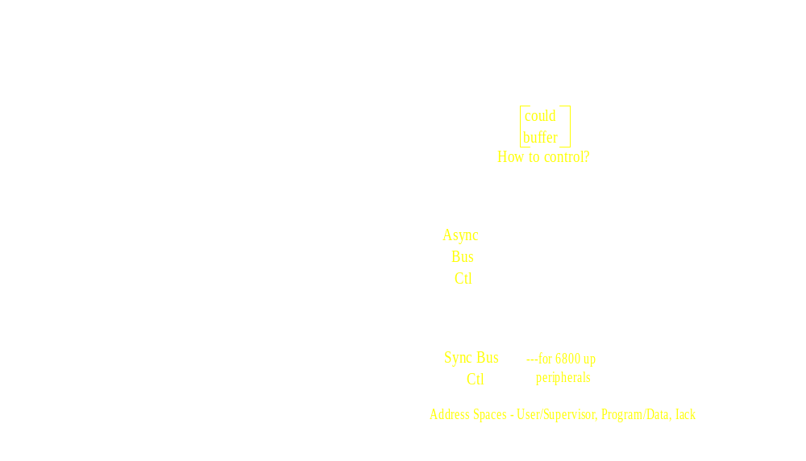
68000 Microprocessor Interface Signals (1)

Slide 12
68000 Microprocessor Interface Signals (2)

Slide 13
68000 Microprocessor Interface Signals (3)
68000
Control
Signals
(which?)
Memory-Mapped I/O Space
Lower-level Integration - must use custom designed “glue” part (PLDs?)
“Big Endian”

Slide 14

8086 Micropocessor Interface Signals (1)

Slide 15
8086 Micropocessor Interface Signals (2)

Slide 16
8086 Micropocessor Interface Signals (3)
2 Interface Configurations
  Minimum Mode - small, single processor
  Maximum Mode - large, multi-processor or coprocessor
Separate (port-mapped) I/O space
Highly integrated “glue” parts available
“Little Endian”

Slide 17
8051 Microcontroller
Complete, highly-integrated microcomputer
  CPU, RAM, ROM, IO
Port 0
  8-bit bidirectional I/O port OR
  multiplexed low-order address and data bus bytes
Port 1
  8-bit bidirectional I/O port
Port 2
  8-bit bidirectional I/O port OR
  high-order address byte
Port 3
  8-bit bidirectional I/O port OR
  various special-function signals

Slide 18
8051 Microcontroller Interface Signals (1)

Slide 19
8051 Microcontroller Interface Signals (2)

Slide 20
Basic Hardware Summary

